Slide 1
Hydrogen Fuel Cell Vehicle
Nora Jiang
Professor Carr Everbach

Slide 2
Table of contents
01
02
03
Introduction
Current
Project
Future
Considerations

Slide 3
01
Introduction
What is a HFCV? And why is there one sitting in the High Bay?

Slide 4
What you need to know first
Hydrogen (H₂) as a fuel?
Why switch to H₂
H₂ is an energy carrier (like gasoline)
Energy is produced through electrolysis
Stored as a liquid before entering the fuel cell
H₂ is incredibly energy dense
Clean in comparison to gas
Large range before needing to refuel

Slide 5
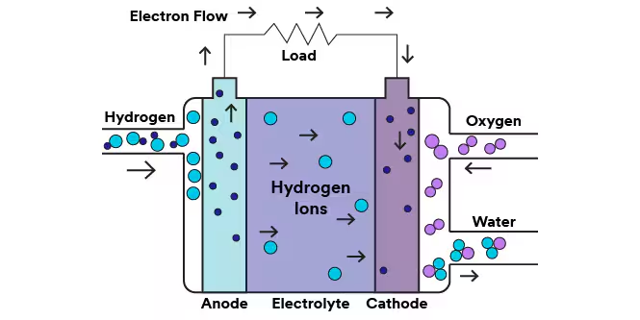
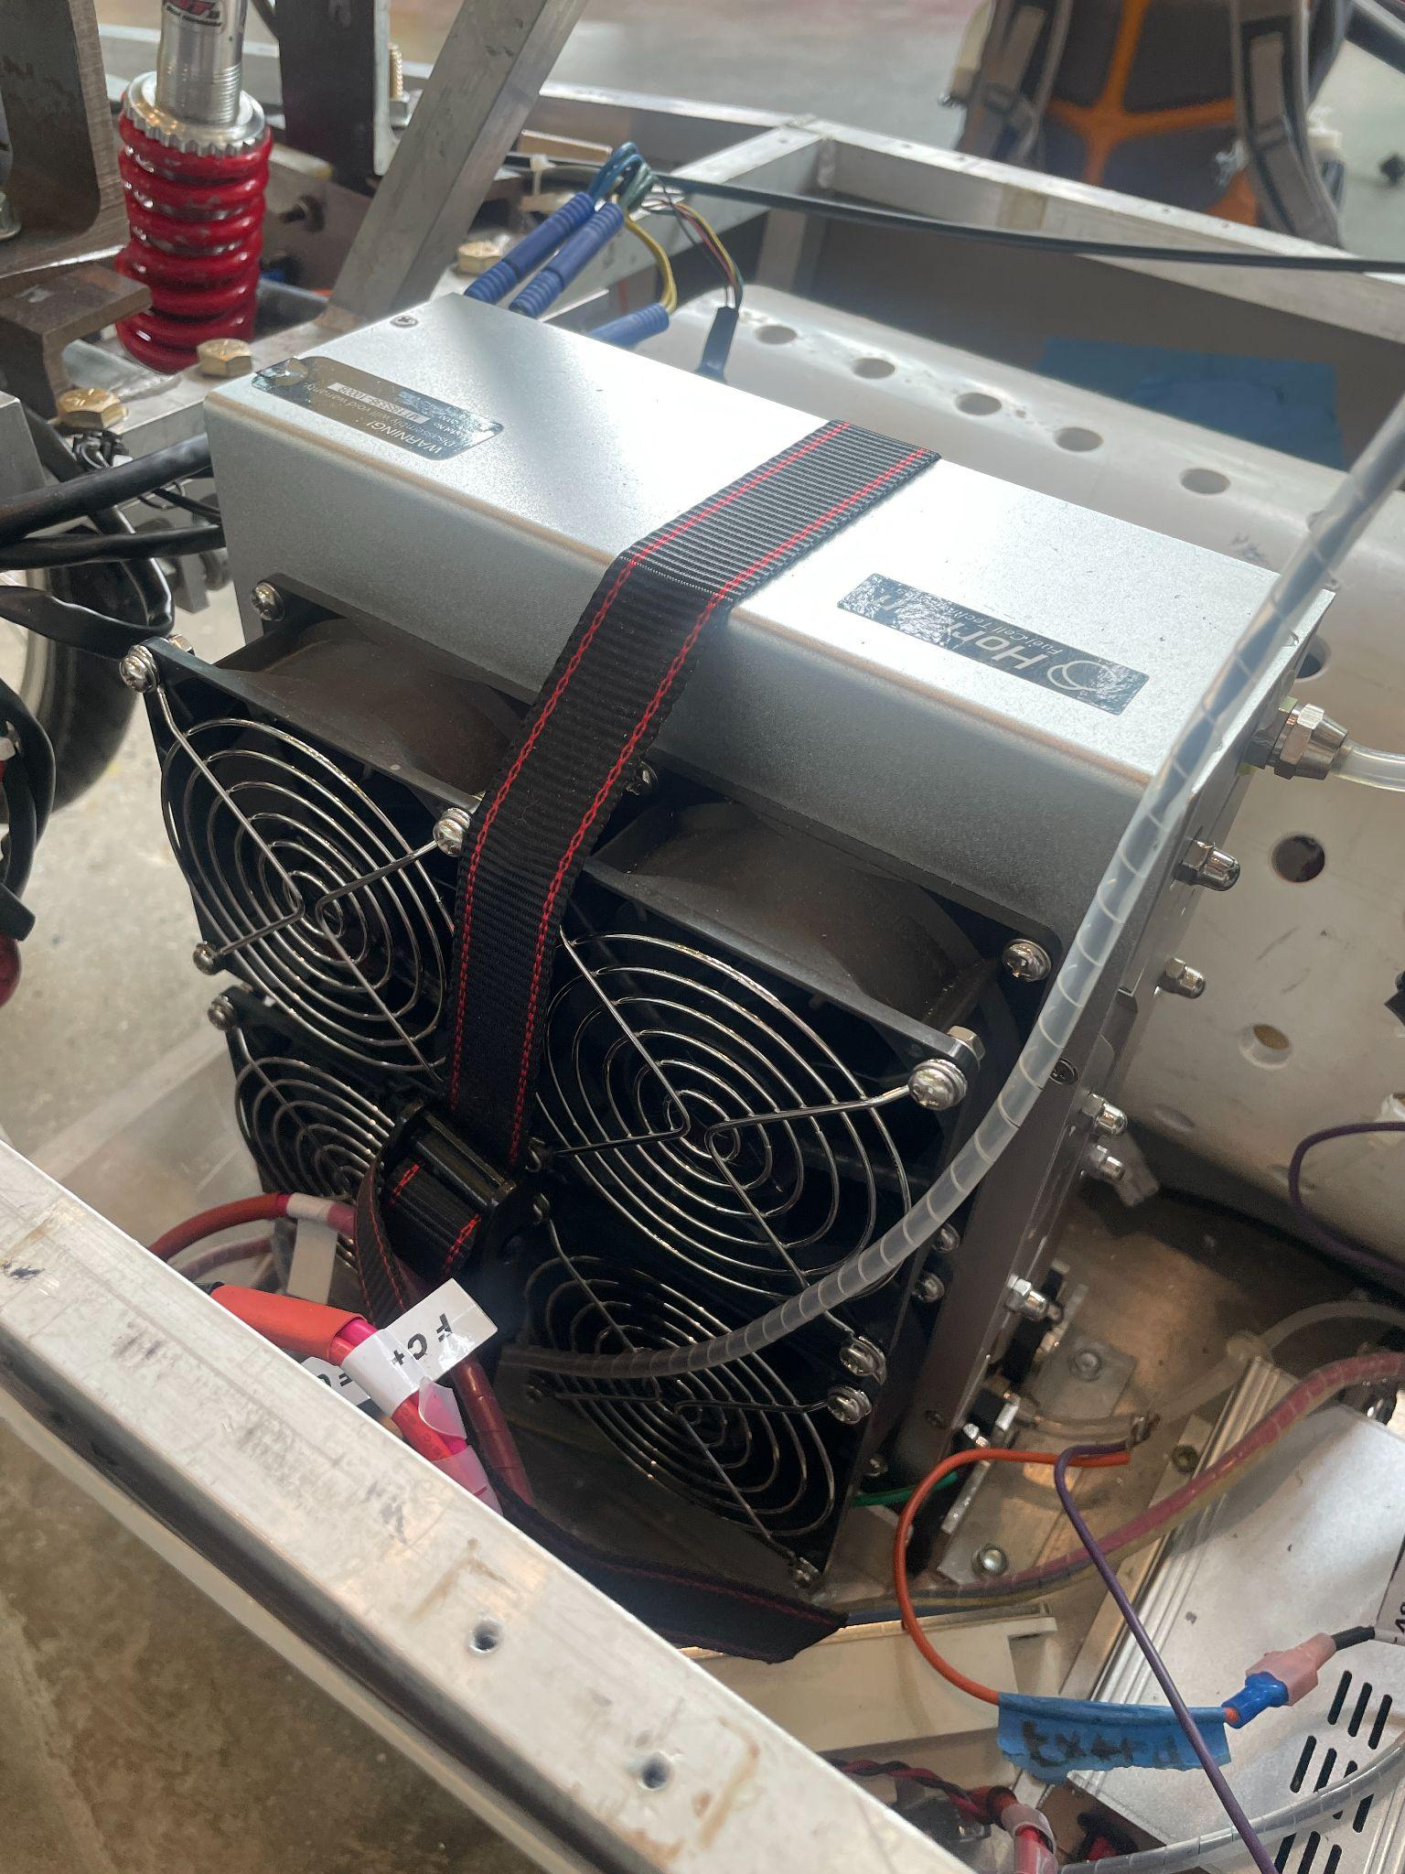
Inside the Fuel Cell
Our Actual Fuel Cell
Photo Courtesy of 3M

Slide 6
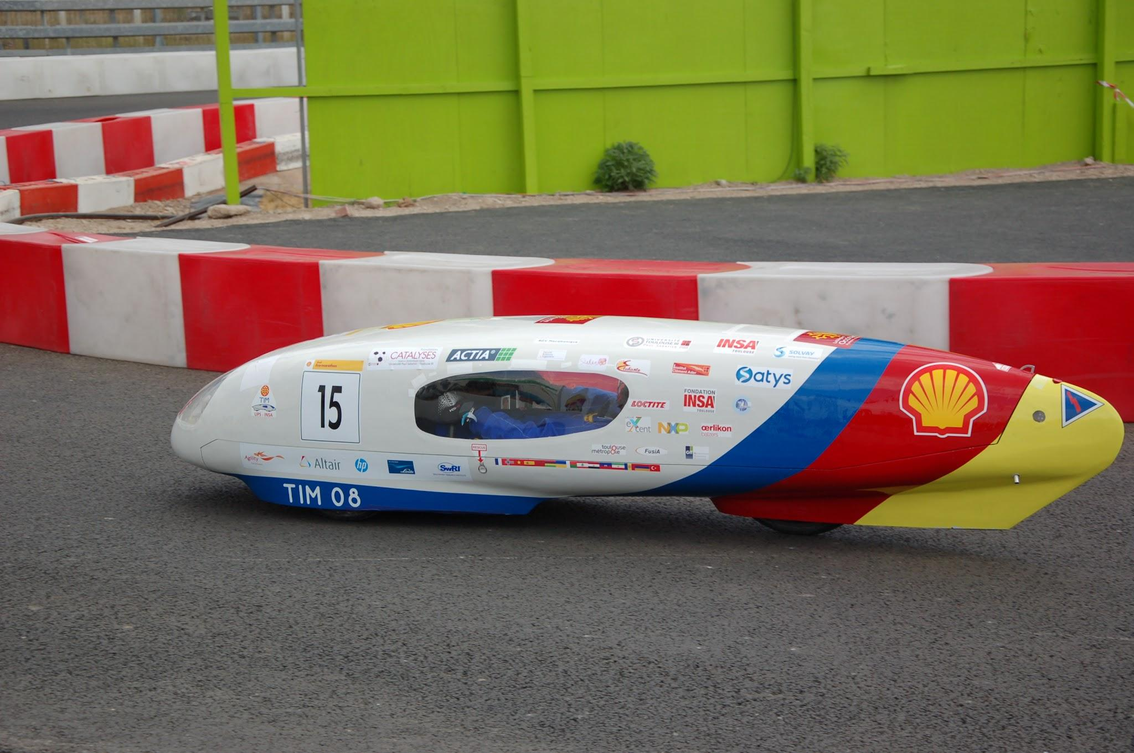
Shell Eco Marathon
What Is It?
Competition to make the most energy efficient vehicle
Why Compete?
Gives a target for our work on the vehicle
Photo Courtesy of Shell Eco Marathon

Slide 7
02
Current Project
Rebuilding the Chassis

Slide 8
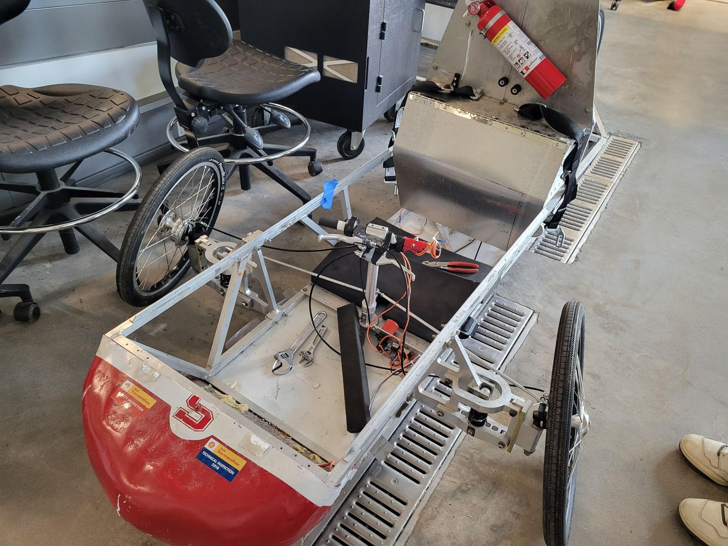
Before This Summer
Previous vehicle
  No longer adheres to Shell’s safety standards
  Needs a complete rebuild before competition ready
Revitalization w/ Ben, Jano, and Justin
  Materials testing
  Preliminary Chassis Design
  Rear Brakes and Suspension system

Slide 9
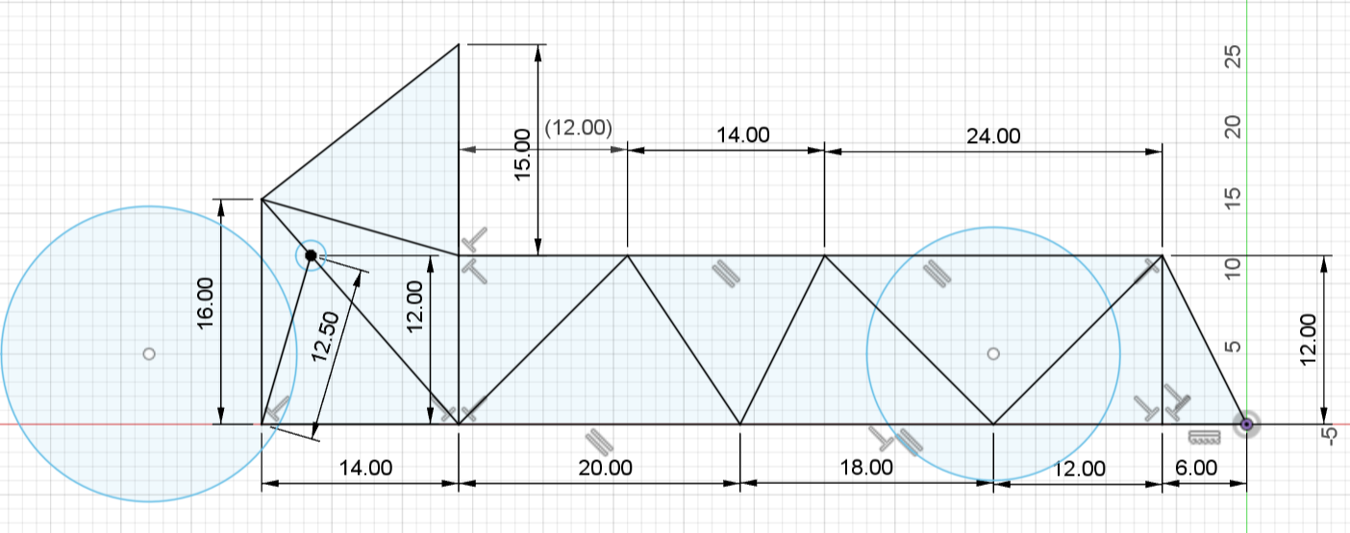
Rough Design From Ben and Justin

Slide 10
Goal:
New Front End

Slide 11
What will that take?
2
Choosing Components
4
Construction
What suspension to use? What size of wheels to use?
Actually putting together the front end
1
Fabrication Techniques
3
Front Chassis Design
5
Learning how to weld, 3D print, and Lathe
Using the general idea left by Ben and Justin, create a new design
Completion

Slide 12
03
Future Considerations
Rebuilding the rest of the HFCV

Slide 13
Fall 2024
Rear of Chassis
Floor of Vehicle
Build and fit the rear wheel + suspension system
Purchase components and assemble
Electrical Components
Wire the new car and put in the hydrogen system

Slide 14
Spring 2025
Cowl Design and Build
Compete
Build the Cowl for the vehicle so that its not a skeleton
Transport Team and Car to Indiana
Testing
Testing entire system to the Shell Eco Marathon Requirements

Slide 15
Thank you for listening
Questions, Comments, Concerns?
njiang1@swarthmore.edu
avasque1@swarthmore.edu
ceverba1@swarthmore.edu

